Slide 1
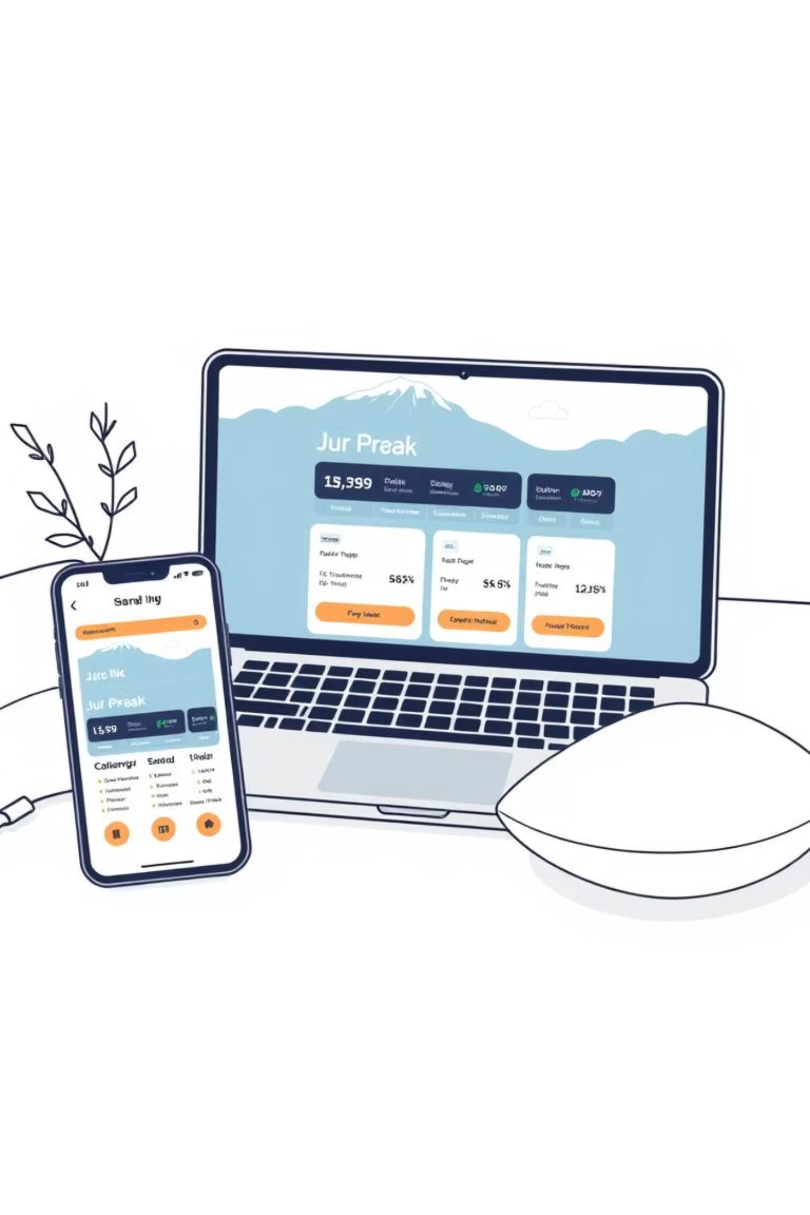
TravelTide Customer Retention Case Study
A data-driven approach to transforming customer loyalty through personalized rewards and strategic segmentation
Presented by Chaitali Arankalle

Slide 2
Agenda
1
2
3
Business Understanding
Problem Statement
Solution Approach
TravelTide's market position and competitive landscape analysis
Identifying retention challenges and their business impact
Data-driven methodology for personalized rewards program
4
5
6
Customer Segmentation
Tableau Dashboard
Pros and Cons
RFM analysis and behavioral clustering insights
Interactive analytics and visualization platform
Strategic assessment of approach benefits and risks
7
Future Recommendations
Long-term strategy and implementation roadmap

Slide 3
Business Understanding
Founded in 2021 (post-COVID) as an innovative e-booking platform designed to capture the surge in digital travel demand following the pandemic recovery.
Competitive Edge: TravelTide differentiates itself through the largest travel inventory in the market combined with best-in-class search technology that delivers personalized results in milliseconds.
Business Challenge: Despite experiencing rapid user acquisition and growth, the company faces a critical weakness in customer retention that threatens long-term profitability and market position.
Business Goal
Core Customer Value
Launch a comprehensive personalized rewards program that significantly boosts customer loyalty, increases engagement rates, and creates sustainable competitive differentiation in the crowded travel booking market.
Save time
Tailored travel experiences
Deals + personalization

Slide 4


Problem Statement
Core Problem
Business Impact
TravelTide demonstrates rapid customer growth in new user acquisition but suffers from significantly low retention and loyalty rates, creating an unsustainable business model that prioritizes volume over value.
High churn rate results in customers migrating to competitors, while low repeat booking rates severely limit customer lifetime value and long-term revenue growth potential.
Root Causes
Affected Key Performance Indicators
Limited personalization in customer experience across booking journey
Customer Retention Rate
Customer Lifetime Value (CLV)
Rewards and perks not strategically aligned with diverse customer preferences and behaviors
Rewards Program Sign-up Conversion
Repeat Booking Ratio
Underdeveloped customer engagement strategy beyond initial bookings
Marketing Campaign Effectiveness
Lack of data-driven insights to understand customer segments and motivations

Slide 5







Solution Approach
Primary Goal
Increase customer retention through a personalized rewards program powered by sophisticated data-driven segmentation that transforms one-time users into loyal brand advocates.
Data Exploration & Cleaning
Feature Engineering
Customer Segmentation
Personalized Rewards
Tableau Dashboard
Ensure reliable, high-quality dataset foundation
Build comprehensive behavioral and demographic metrics
Define 3-5 distinct, actionable customer groups
Assign targeted perks to each identified segment
Track insights and enable data-driven decisions
Expected Business Outcomes
Rewards Sign-ups Increase
Reduced Churn Rate
Higher Repeat Bookings
Target improvement in program adoption
Focus on high-risk segment intervention
Strengthen loyalty and customer lifetime value

Slide 6







Customer Segmentation Strategy
Frequency
Behavioral Enhancement Factors
Booking frequency patterns reveal customer loyalty depth and travel habits consistency
Cancellation habits → Risk assessment and flexibility needs
Family status indicators → Group booking preferences and package deals
Recency
Device usage patterns → Mobile-first vs desktop preferences
How recently customers made their last booking, indicating current engagement levels and likelihood to return
Monetary Value
Seasonal booking trends → Business vs leisure travel identification
Total spending patterns indicate customer lifetime value potential and price sensitivity
Reward Design Logic
Each segment's RFM profile combined with behavioral signals directly informs personalized perk assignments. High-frequency business travelers receive premium flexibility features, while budget-conscious explorers get targeted discounts. This data-driven approach ensures rewards match actual customer preferences rather than generic offerings.

Slide 7
Segment and Reward Mapping
Customer Segment
Matching Reward Strategy
Frequent Business Travelers
Free cancellation policies, express check-in privileges, priority customer support, and flexible booking modifications
Budget-Conscious Explorers
Exclusive flight and hotel discounts, early-bird pricing alerts, price-drop notifications, and budget travel tips
Family Vacationers
Family package deals, child-friendly accommodation perks, group booking discounts, and kid-activity recommendations
Luxury Experience Seekers
VIP perks, premium room upgrades, exclusive experiences, concierge services, and luxury travel recommendations
At-Risk / Dormant Users
Re-engagement offers, bonus points for return bookings, personalized travel inspiration, and win-back incentives
Mobile-First Millennials
App-only exclusive deals, gamified rewards system, social sharing incentives, and mobile-optimized booking experiences
This strategic mapping ensures that each customer segment receives rewards that align with their specific travel behaviors, preferences, and value drivers, maximizing engagement and loyalty potential.

Slide 8
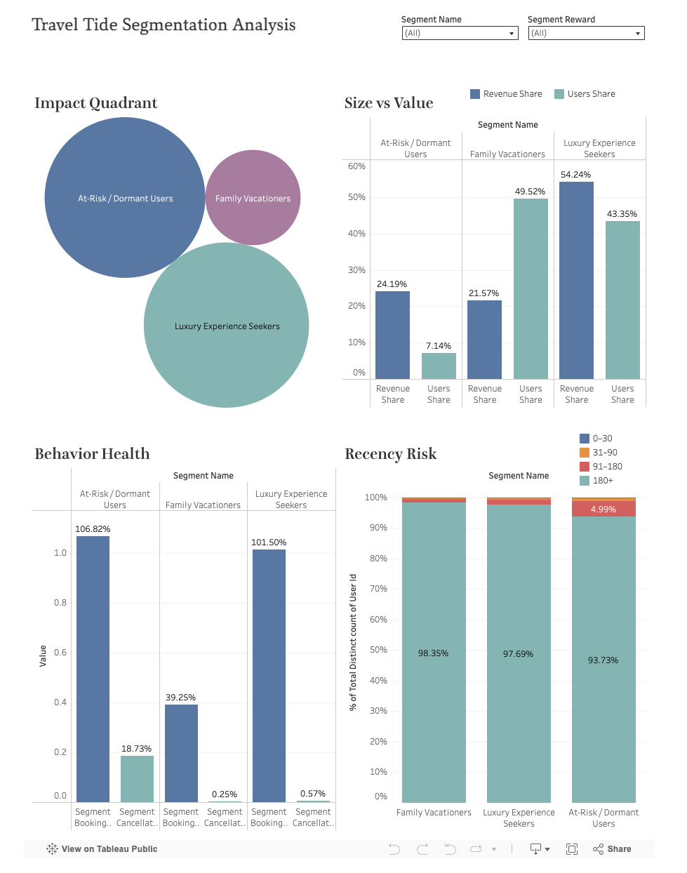
Tableau Dashboard and Analytics Platform
Dashboard Screenshot Preview
Live Dashboard Link: 👉 Travel Tide Segmentation Analysis – Interactive Tableau Dashboard
Key Visualizations:
Impact Quadrant
Size vs Value
Behaviour Health
Recency Risk

Slide 9


Strategic Assessment: Pros and Cons
✅ Possible Benefits of This Approach
❌ Potential Risks if Not Implemented
Improved customer retention & loyalty through targeted, personalized experiences that resonate with specific customer needs
Continued low retention & high churn leading to unsustainable customer acquisition costs and reduced profitability
+15–20% higher rewards sign-ups achieved through precision targeting and relevant incentive matching
Weak rewards program adoption resulting in missed opportunities for customer engagement and loyalty building
Enhanced customer insights via advanced segmentation and interactive dashboards that inform future strategy
Generic marketing campaigns that fail to resonate with diverse customer segments, reducing effectiveness and ROI
Scalable framework for future marketing strategies that can evolve with business growth and market changes
Lost conversion opportunities from one-time users to repeat customers, limiting long-term revenue growth
Stronger competitive edge in the travel e-booking market through differentiated, data-driven customer experiences
Competitive disadvantage as competitors implement more sophisticated personalization strategies
Measurable ROI from targeted marketing campaigns and personalized customer journeys
Reduced market share in an increasingly competitive travel booking landscape
The strategic choice is clear: implementing this data-driven segmentation approach is essential for TravelTide's long-term success and market competitiveness.

Slide 10




Future Recommendations
2. Dynamic Segmentation
1. Enhance Data Collection
Refresh clustering models regularly (quarterly basis) to capture seasonal shifts, evolving travel behaviors, and emerging customer patterns. Implement automated model updates to ensure continued relevance.
Expand datasets with comprehensive customer feedback, loyalty engagement metrics, and detailed app usage patterns to deepen insights and improve segmentation accuracy. Implement advanced tracking mechanisms for behavioral analysis.
4. Long-Term Strategic Evolution
3. KPI Monitoring & ROI Tracking
Integrate external market data including seasonality trends, competitor pricing intelligence, and macro travel trends. Progress from descriptive segmentation to predictive modeling for churn prediction and upgrade likelihood assessment.
Continuously monitor retention rates, CLV, churn indicators, and rewards adoption through integrated Tableau dashboards. Establish clear before vs. after program launch metrics to quantify business impact and ROI.
Next Phase: Prescriptive Analytics
Evolve the platform into prescriptive analytics that automatically recommends the right perk at the right time for each individual user, creating a truly personalized and anticipatory customer experience.

Slide 11
Thank You!

